Slide 1
E-Safety
It is important that we understand enough about the Internet to keep our children safe from harm but it is equally important that we equip our children with the skills they need to keep themselves safe so they can experience the Internet positively and responsibly.
Notes:
How many of these apps can you name?
Which of them do you know about?

Slide 2
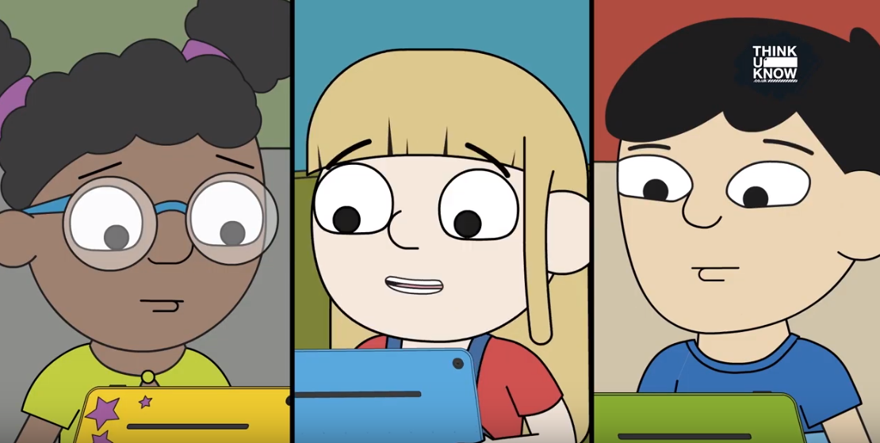

Slide 3
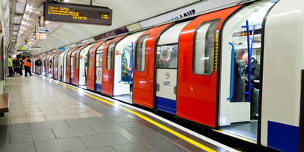
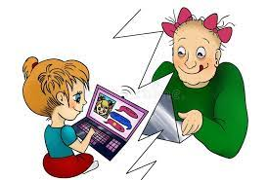
Would you let your child ride a train on their own without prior guidance and support?
They need the same guidance and support in this situation too!

Slide 4
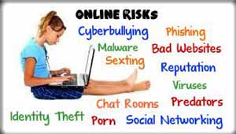
Some common dangers to be aware of:
Notes:
radicalisation, extremism, grooming, trafficking, paedophiles,

Slide 5
Responding safely to risks
Modelling the importance of keeping personal information safe.
Making children aware of the abusive behaviours they may come across on gaming platforms and social media.
Showing them how to respond safely if they think someone is trying to manipulate, pressure or threaten them.
Encouraging them to seek help from adults they trust.
Guiding them towards appropriate sources of help should they need it.

Slide 6
Please talk through this document with your children each half term and give reminders often.

Slide 7
The lasting effects of posting online…
Remind children of their online etiquette
Not sending or posting anything that could be considered threatening, bullying, offensive or illegal.
Implications of a post lasting forever (even if you think you have removed it – it may already have been screenshot and shared)

Slide 8
Tips for the home
Monitor the different types of Internet technology
Use in a high-traffic area of your home
Establish limits for which sites and duration
Understand the settings and show them how to protect themselves
Set rules and stick to them
Watch for apps linked to your bank account details
Switch ‘off’ the location in the settings
Click for more tips
Notes:
Monitor all types of Internet technology mobile phones, gaming devices, tablets, computers and laptops
Use in a high-traffic area of your home
Establish limits for which online sites children may visit and for how long. Create a family agreement for internet use.
Be a part of their online life; involve the whole family and show an interest. Find out what sites they visit and what they love about them.
Understand the settings and show them how to protect themselves.
No filter or parental controls tool is 100% effective, and many of the risks that young people face online are because of their own and other’s behaviour.
Set rules for social networking, messaging, e-mailing, online gaming and using webcams or live streaming. Be aware if your children are using devices or apps linked to your bank details and accounts
Remember if location is switched ‘on’ in the settings, then you can be located.

Slide 9
What to do if your child sees inappropriate material online
Don’t overreact - dealing with it calmly, your child will know they can turn to you again in the future
Keep records and screen shot evidence
Use these links to report it
www.iwf.org.uk or www.ceop.police.uk
Your child can ring Childline for support 0800 1111
Notes:
Don’t overreact if your child tells you about something they have seen. You might feel shocked and an­gry but by dealing with it calmly your child will know they can turn to you again.
Keep records of abusive messaging.
Report abusive or inappropriate behaviour to the website and if serious, to the police. If you come across illegal content, such as images of child abuse, you can report this to the Internet Watch Foundation at www.iwf.org.uk or www.ceop.police.uk
Your child can also ring Childline for support 0800 1111

Slide 10
Helpful websites
www.esafetytraining.org/parent-carers-area
www.thinkuknow.co.uk/parents/
www.saferinternet.org.uk/
www.childnet.com/parents-and-carers
www.commonsensemedia.org
Follow EST E Safety Training page on Facebook for latest tips about apps

