Slide 1
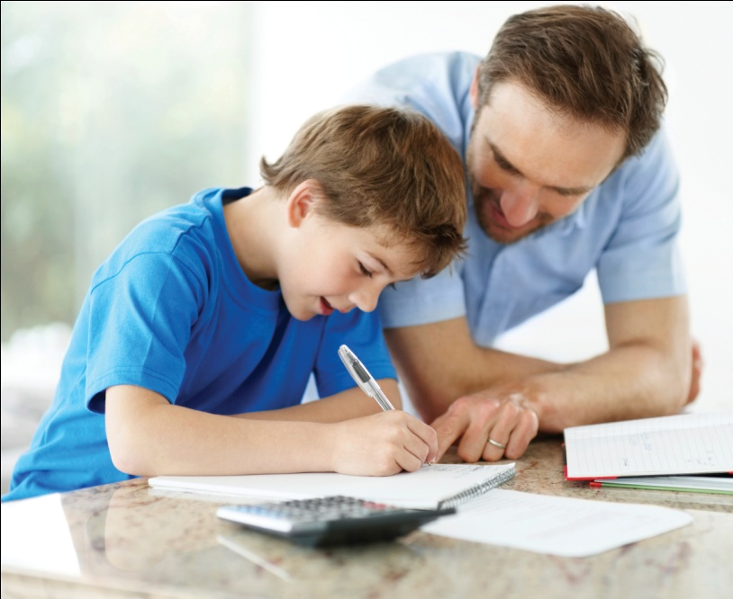
Welcome to our Junior Support Evening

Slide 2
Introduction
Teachers in KS 2:
Year 3 – Mrs. Ashton (3/4 phase leader)
Year 4 – Mrs. Baptiste
Yr 3/4 teacher – Mrs. Goddard
Year 5 – Mr. Horne
Year 6 – Miss Penkett (Deputy Head)
Year 6 group teacher – Mrs. Nott (Inclusion Manager)
Feel free to ask questions and share comments.

Slide 3
Maths – Mrs. Baptiste
Different methods: addition, subtraction, multiplication and division
Calculation Policy – use the correct methods
Word problems / reasoning – get children to explain how to solve
Practise mental maths and calculations: money, time, tables and division facts, number bonds

Slide 4
Reading – Miss Penkett
How we teach reading in school
Book challenges
Year 3/4 – 1 reading book, 1 library book
Year 5/6 – 1 or 2 books at an appropriate level
Book levels: colours, S and S+ books
Older children still need to read aloud in order to support pronunciation, expression and vocabulary

Slide 5
Mrs. Ashton- Supporting your child at home
Listen to your child read 4/5 times a week
Encourage them to look up unknown words in a dictionary
Please sign their reading diaries as these will be checked – Radical Readers
Ask questions about their books
Encourage them to read different genres or texts

Slide 6
Writing – Miss Penkett
Neat, joined handwriting
Use black pen, when they have received a ‘pen licence’
Spellings
Spoken language
Talk for Writing
G.P.S.

Slide 7
General – Mrs. Nott
Groups Yr 3/4 and Yr 5/6
Homework: set on Thursday 3 & 4 / Friday 5 & 6
Children need a named water bottle and snack for playtime (only fruit and vegetables)
Take responsibility for their own belongings
Marking: Next Step Targets that we discuss with the children in class
Tested termly on Comprehension, G.P.S., Writing and Maths
Targets at the end of the term – keep children and parents informed
Intervention groups
End of Year Reports: G, S, D, E

Slide 8
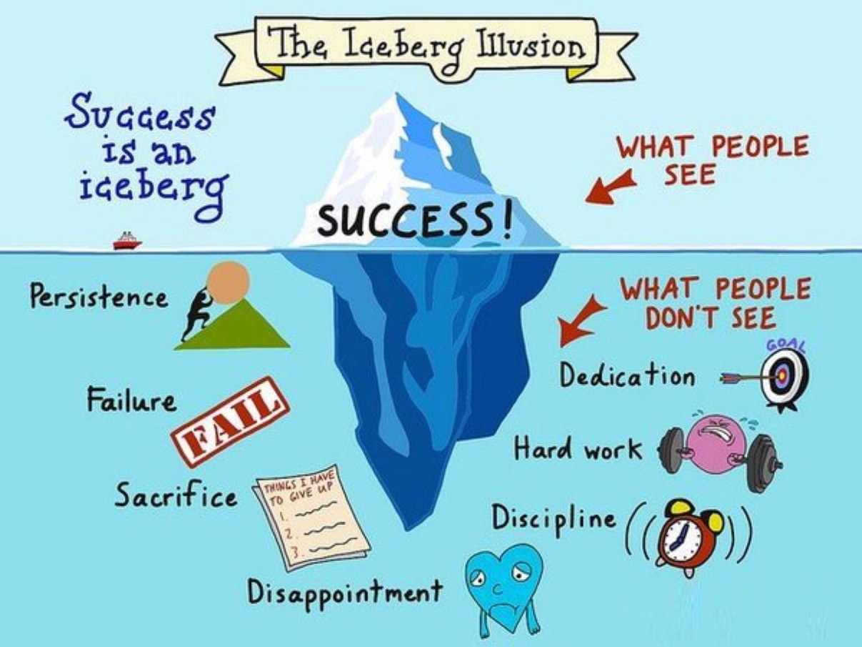
Values- Miss Miller
Roles of responsibility- jobs, supporting others,
Increased Independence
Values
Opportunities
Life long learners

Slide 9
Thank you for coming and for your continued support.
Please feel free to ask the teachers any questions you may have.

