Slide 1
Maths
Helping Your Child with Their Maths at Home

Slide 2
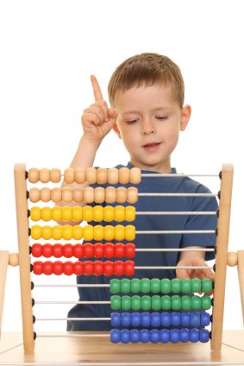
Maths in the Infants
Progression in number work
Methods we use for the operations
Other maths in the infants
How to help your child at home

Slide 3
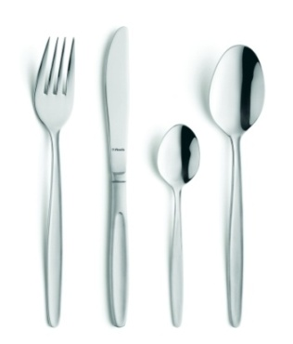
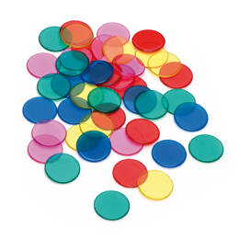
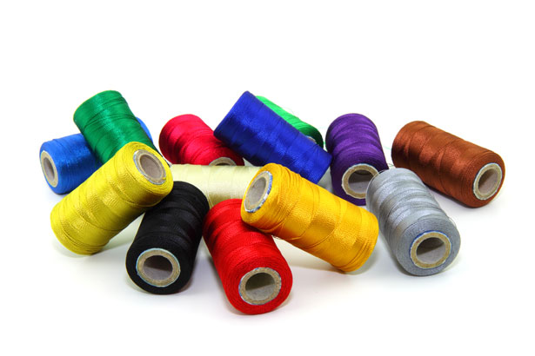
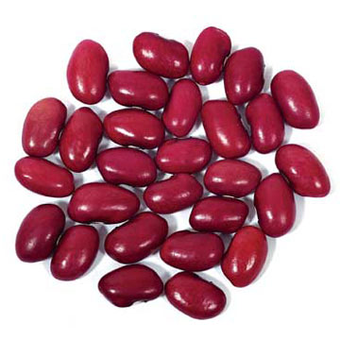
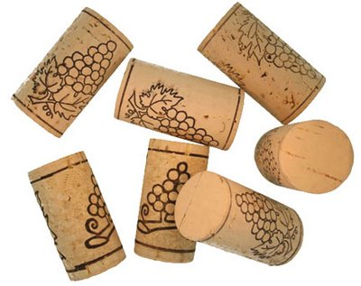
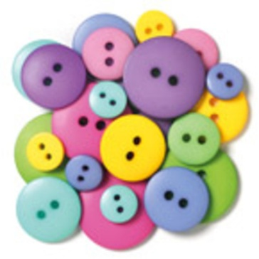
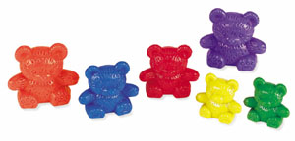
Counting using Objects
Count up to 10 and beyond
Relate the numbers to objects
Counting systematically

Slide 4
Counting using Objects
The first step in children’s number work is counting up to 10 and beyond.
Children then need to understand how to relate the numbers to objects.
They need to come up with a system so that they do not miss objects.
We encourage children to put the objects in a line and start from one side.
We also encourage them to touch the objects as they count them.

Slide 5
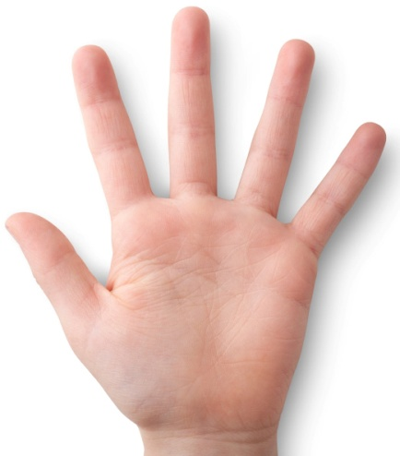
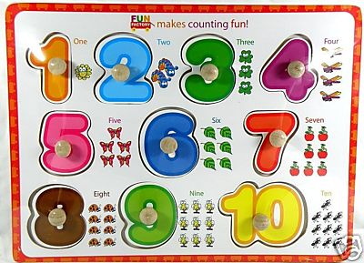
Relating amounts to number
Children then need to be able to recognise the numbers that they are using to count. Relating the numbers to a numeral is quite a big jump for some children. The more familiar they are with the numerals, the quicker they will learn them.
= 5
= 6

Slide 6

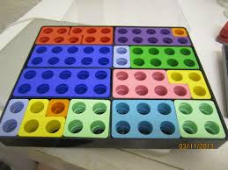
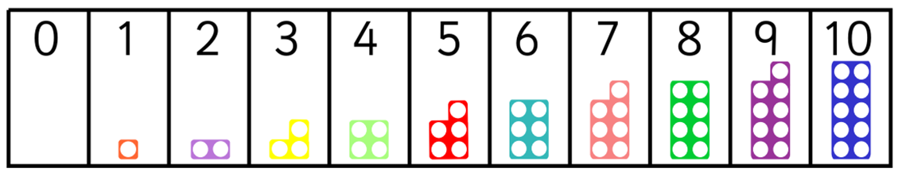
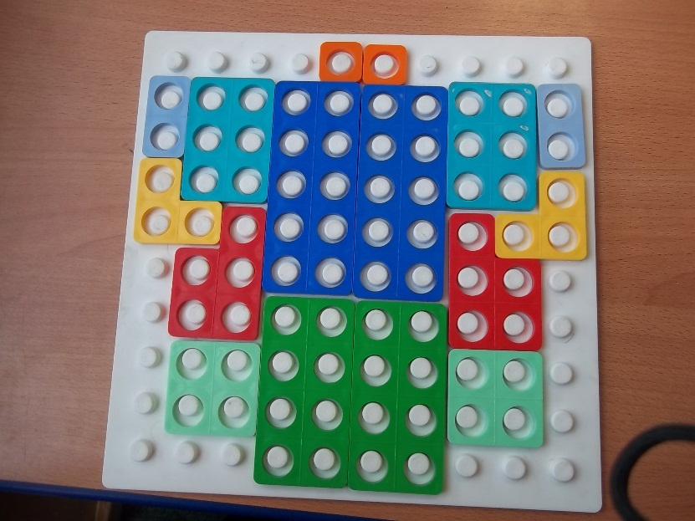
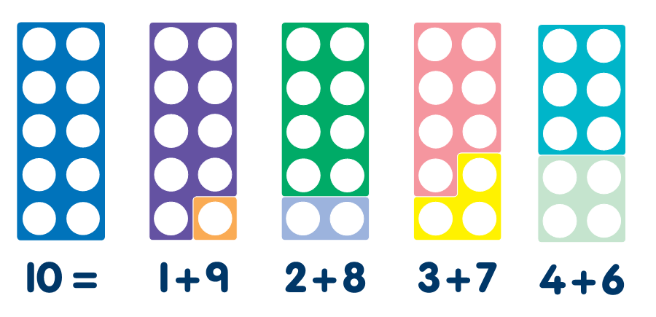

Slide 7
Recognising and Writing numbers
This is how we write numbers in our school. The earlier children practise writing numbers the right way round the less likely they are to get into the habit of writing them incorrectly. In early number formation 2 and 5 are easily confused.
2
3
5
6
7
8
0

Slide 8
Ordering numbers
2
5
3
2
3
5
Key Words:
More than
Less / fewer than

Slide 9
Ordering numbers
9
3
2
7
2
2
3
7
9
2
Key Words:
More than
Less / fewer than

Slide 10
Place Value
A child having a deep understanding of place value is integral to their progression in maths.
Once they are familiar with numbers over 10 we work on identifying the ‘tens digit’ and the ‘ones’ in each number.
It is important that the children know the value of each digit.
In this example 13 is made up of ‘1 ten’ and ‘3 ones’
Place Value cards are one resource we use to support this concept.
3
0
0
3

Slide 11
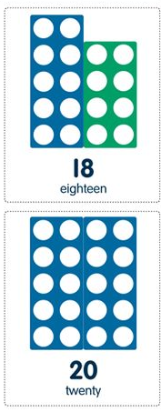
Place Value
In school we also use tens rods and ones cubes to help children understand that 10 ones is the same as one set of 10. We also use numcon.
= 10
= 1
= 36
You could support this idea at home when they are counting numbers greater than 10, by grouping objects together in tens as they count up.

Slide 12
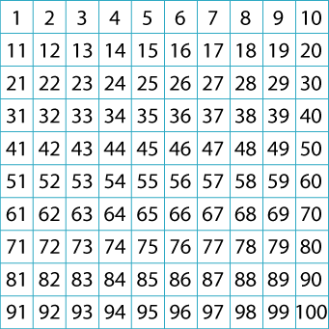
Place Value
The children need to be able to locate given numbers in a hundred square by identifying the tens digit of that number first then finding the corresponding row. They should also know that the higher the tens digit, the lower the row is located in the hundred square.
Key Words:
tens /ones digit
teens number

Slide 13
Number Facts
A ‘number bond’ is two numbers which are added together to make another number. 10 = 8 + 2
Use number bonds to mentally calculate e.g. 56 + _ = 60
Another vital mental maths skill is doubling numbers up to 5 /10 / 20. This is first taught using hands and then pictures.
After this, the children will then learn the inverse of doubling: halving.

Slide 14
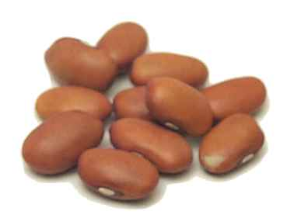
Addition and Subtraction Using Objects
We often get asked what objects children should use to help them add up at home...... ANYTHING!!!
For addition, ask children to count out two groups of objects, combine them and see how much there is ‘altogether’.
For subtraction, encourage children to count out the larger group then ‘take away’ the smaller number and see ‘how many are left’.
We use lots of different words for addition and subtraction, and we do not introduce the + and – symbols until children are very confident with the operations.

Slide 15
Using a number line to add
Children can start to use a number line for addition and subtraction when they start to have a better understanding of abstract number.
It is important that they relate addition to ‘counting on’ and subtraction to ‘counting back’ on the number lines.
They must understand that, with addition, the total amount will be the largest and, when taking away, the result will be smaller than the initial amount.
1 2 3 4 5 6 7 8 9 10 11 12 13 14 15 16 17 18 19 20 21 22 23 24
12 + 8 =

Slide 16
Addition in year two
In year two, the children will use their knowledge of place value to help with calculating addition problems.
Here is an example: 12 + 13 =
First they will partition the tens and calculate.
Then they partition the units and calculate.
Finally the totals are recombined to find the final answer.
TU TU
12 + 13 = 25
10 2 10 3
10 + 10 = 20
2 + 3 = 5

Slide 17
Using a number line to subtract
20 – 8 =
When subtracting, children will need to understand that they can start with the largest number and count back.
1 2 3 4 5 6 7 8 9 10 11 12 13 14 15 16 17 18 19 20 21 22 23 24
We also learn to ‘find the difference’ to solve subtraction number sentences, where they start with the lower number.
1 2 3 4 5 6 7 8 9 10 11 12 13 14 15 16 17 18 19 20 21 22 23 24
12 jumps

Slide 18



Multiplication and Division
We do not use the symbols for multiplication or division until children are confident with the concept of ‘lots of’ as repeated addition and division as ‘sharing’.
Key Words:
Lots of ...
Sets of …
Groups of …
Shared between…
4 lots of 2
2 + 2 + 2 + 2 = 8
6 shared by 3

Slide 19
New National Curriculum
The new National Curriculum states that, by the end of year two, pupils should know how to:
Recall and use multiplication and division facts for the 2, 5 and 10 times tables.

Slide 20
Word problems
Once the children are confident with using the methods of each operation we use word problems so they can apply their skills to ‘real life’ situations.
The problem: Bob had 24 sweets. He ate 6 sweets. How many sweets does Bob have left?
What do I need to do? - (take away)
Write the number sentence and solve it: 24 – 6 =
My answer:
When the children are familiar with more than one operation (e.g. addition and subtraction), an important part of word problems is deciding what operation to use.

Slide 21
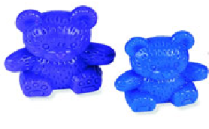
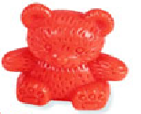
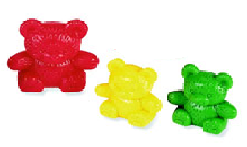
Other Maths in The Infants
Patterns
Sorting

Slide 22
Other Maths in The Infants
2D Shape
Key Words:
Corners
Sides
Straight
Curved
3D Shape
Key Words:
Faces
Edges
Vertices

Slide 23
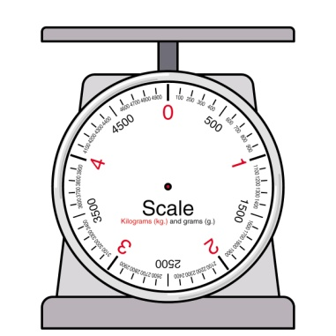
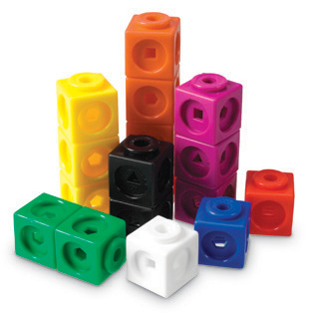
Other Maths in The Infants
Key Words:
Estimate
Length – long, tall, wide
thick thin......not ‘big’
Mass – weigh, light, heavy
Capacity – full, empty
Measuring

Slide 24
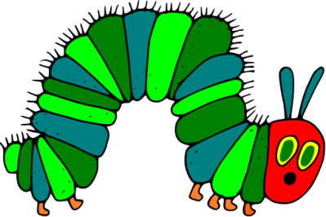
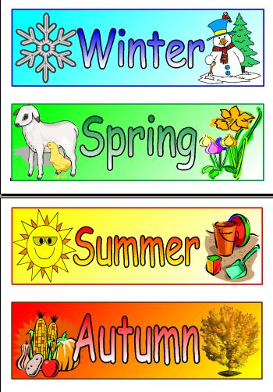
Other Maths in The Infants
Time
Sequencing events.
Times of day, e.g. morning, afternoon,
Days, then months, in order.
Analogue & digital clock

Slide 25
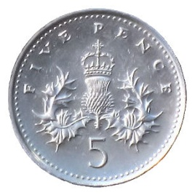
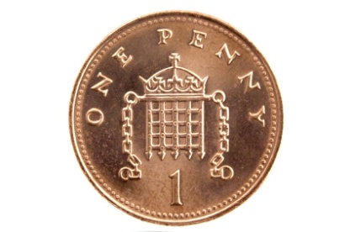
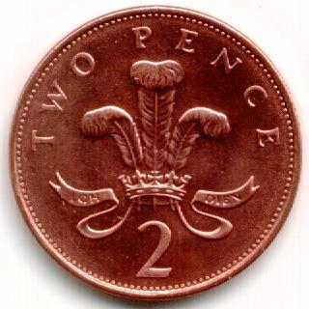
Money
Need to recognise coins and know the value of each.
When counting small amounts, tap the coin the correct amount of times.
Making totals, first with 1ps, then using other coins.
Adding and subtracting amounts.
Finding change.
The more opportunity your child has to use money, the easier they will find maths related to it.

Slide 26
Language in Maths
Please see the vocabulary lists below, to show words used in maths lessons in the infants.
We encourage children to verbalise their understanding and explain how they have got their answer.
Talking about maths reinforces the children’s understanding and allows us to find any misconceptions they may have.

Slide 27
Key Vocabulary in Mathematics
Number Operations
There are four operations, sometimes called the four rules of number and each is represented by a sign.
+ Addition | - Subtraction | x Multiplication | ÷ Division
Add Plus Count on Total Altogether More of Sum of | Take away Count back Less Difference of Subtract Fewer | Lots of Sets of Groups of Product Times | Share Divide Split between Groups of

Slide 28
Key Vocabulary in Mathematics
Place Value single digit (0 – 9) teens number (11 – 19) hundreds digit 342 tens digit 342 ones digit 342 | Using number Sequence (number pattern) Number bond (two numbers that together make another number) Double / Halve Inverse (opposite of, e.g. + is inverse of -) Number sentence (previously called a sum but please refer to is as number sentence) Ordering Greater / more than Fewer / less than Estimate OR a sensible guess

Slide 29
Key Vocabulary in Mathematics
Shape
2D Shape | 3D Shape
Sides Corners Angles Straight Curved | Faces Vertices Edges Flat

Slide 30
Supporting your children.
These are some of the ways in which you can support your children at home:
Hearing your child read 2-3 times a week and signing the diary. Positive and constructive comments welcome.
Use the new reading diaries to practise phonics, spellings and unfamiliar vocabulary.
Help with weekly homework tasks and have high expectations of presentation and effort. These will include phonics, EPGS and maths tasks.

Slide 31
Thank you for coming.
Any questions?
Please see our school website for a copy of this handout.
http://www.huttonallsaints.co.uk/

Slide 32
Useful websites for maths games to play at home:
EYFS:
http://www.oxfordowl.co.uk/welcome/for-home/maths-owl/maths
http://www.ictgames.com/primaryStrategy1.html
http://www.iboard.co.uk/activities/subject/maths
http://www.topmarks.co.uk/maths-games/3-5-years/counting
http://www.crickweb.co.uk/Early-Years.html (maths and literacy)
http://www.teachingideas.co.uk/earlyyears/contents_maths.htm
http://www.comberps.newtownards.ni.sch.uk/maths_games_for_early_years.htm
http://www.bbc.co.uk/schools/websites/eyfs/
http://www.earlylearninghq.org.uk/numeracy/
Year one and two:
http://www.topmarks.co.uk/
http://www.mathschamps.co.uk/#home
http://www.primarygames.com/
http://mathszone.co.uk/
http://www.mathplayground.com/
http://www.bbc.co.uk/bitesize/ks1/maths/

